Slide 1
16
Exception Handling

Slide 2
I never forget a face, but in your case I’ll make an exception.
  Groucho Marx
It is common sense to take a method and try it. If it fails, admit it frankly and try another. But above all, try something.
  Franklin Delano Roosevelt
O! throw away the worser part of it, And live the purer with the other half.
  William Shakespeare

Slide 3
If they’re running and they don’t look where they’re going I have to come out from somewhere and catch them.
  Jerome David Salinger
O infinite virtue! com’st thou smiling from the world’s great snare uncaught?
  William Shakespeare

Slide 4
OBJECTIVES
In this chapter you’ll learn:
What exceptions are and when to use them.
To use try, catch and throw to detect, handle and indicate exceptions, respectively.
To process uncaught and unexpected exceptions.
To declare new exception classes.
How stack unwinding enables exceptions not caught in one scope to be caught in another scope.
To handle new failures.
To use auto_ptr to prevent memory leaks.
To understand the standard exception hierarchy.

Slide 5
16.1 Introduction
16.2 Exception-Handling Overview
16.3 Example: Handling an Attempt to Divide by Zero
16.4 When to Use Exception Handling
16.5 Rethrowing an Exception
16.6 Exception Specifications
16.7 Processing Unexpected Exceptions
16.8 Stack Unwinding
16.9 Constructors, Destructors and Exception Handling
16.10 Exceptions and Inheritance
16.11 Processing new Failures
16.12 Class auto_ptr and Dynamic Memory Allocation
16.13 Standard Library Exception Hierarchy
16.14 Other Error-Handling Techniques
16.15 Wrap-Up

Slide 6
16.1 Introduction
Exceptions
  Indicate problems that occur during a program’s execution
  Occur infrequently
Exception handling
  Can resolve exceptions
    Allow a program to continue executing or
    Notify the user of the problem and
    Terminate the program in a controlled manner
  Makes programs robust and fault-tolerant

Slide 7
Error-Prevention Tip 16.1
Exception handling helps improve a program’s fault tolerance.

Slide 8
Software Engineering Observation 16.1
Exception handling provides a standard mechanism for processing errors. This is especially important when working on a project with a large team of programmers.

Slide 9
16.2 Exception-Handling Overview
Intermixing program and error-handling logic
  Pseudocode example
  Perform a task
  If the preceding task did not execute correctly
  Perform error processing
  Perform next task
  If the preceding task did not execute correctly
  Perform error processing
  …
  Makes the program difficult to read, modify, maintain and debug

Slide 10
16.2 Exception-Handling Overview (Cont.)
Exception handling
  Removes error-handling code from the program execution’s “main line”
  Programmers can handle any exceptions they choose
    All exceptions,
    All exceptions of a certain type or
    All exceptions of a group of related types

Slide 11
Performance Tip 16.1
If the potential problems occur infrequently, intermixing program logic and error-handling logic can degrade a program’s performance, because the program must (potentially frequently) perform tests to determine whether the task executed correctly and the next task can be performed.

Slide 12
16.3 Example: Handling an Attempt to Divide by Zero
Class runtime_error
  Is a standard C++ base class for creating new exception types
  Provides its derived classes with virtual function what
    Returns the exception’s stored error message

Slide 13
16.3 Example: Handling an Attempt to Divide by Zero (Cont.)
try Blocks
  Keyword try followed by braces ({})
  Should enclose
    Statements that might cause exceptions and
    Statements that should be skipped in case of an exception

Slide 14
Software Engineering Observation 16.2
Exceptions may surface through explicitly mentioned code in a try block, through calls to other functions and through deeply nested function calls initiated by code in a try block.

Slide 15
16.3 Example: Handling an Attempt to Divide by Zero (Cont.)
catch handlers
  Immediately follow a try block
    One or more catch handlers for each try block
  Keyword catch
  Exception parameter enclosed in parentheses
    Represents the type of exception to process
    Can provide an optional parameter name to interact with the caught exception object
  Executes if exception parameter type matches the exception thrown in the try block
    Could be a base class of the thrown exception’s class

Slide 16
Common Programming Error 16.1
It is a syntax error to place code between a try block and its corresponding catch handlers.

Slide 17
Common Programming Error 16.2
Each catch handler can have only a single parameter—specifying a comma-separated list of exception parameters is a syntax error.

Slide 18
Common Programming Error 16.3
It is a logic error to catch the same type in two different catch handlers following a single try block.

Slide 19
16.3 Example: Handling an Attempt to Divide by Zero (Cont.)
Termination model of exception handling
  try block expires when an exception occurs
    Local variables in try block go out of scope
  The code within the matching catch handler executes
  Control resumes with the first statement after the last catch handler following the try block
    Control does not return to throw point
Stack unwinding
  Occurs if no matching catch handler is found
  Program attempts to locate another enclosing try block in the calling function

Slide 20
Common Programming Error 16.4
Logic errors can occur if you assume that after an exception is handled, control will return to the first statement after the throw point.

Slide 21
Error-Prevention Tip 16.2
With exception handling, a program can continue executing (rather than terminating) after dealing with a problem. This helps ensure the kind of robust applications that contribute to what is called mission-critical computing or business-critical computing.

Slide 22
16.3 Example: Handling an Attempt to Divide by Zero (Cont.)
Throwing an exception
  Use keyword throw followed by an operand representing the type of exception
    The throw operand can be of any type
      If the throw operand is an object, it is called an exception object
  The throw operand initializes the exception parameter in the matching catch handler, if one is found

Slide 23
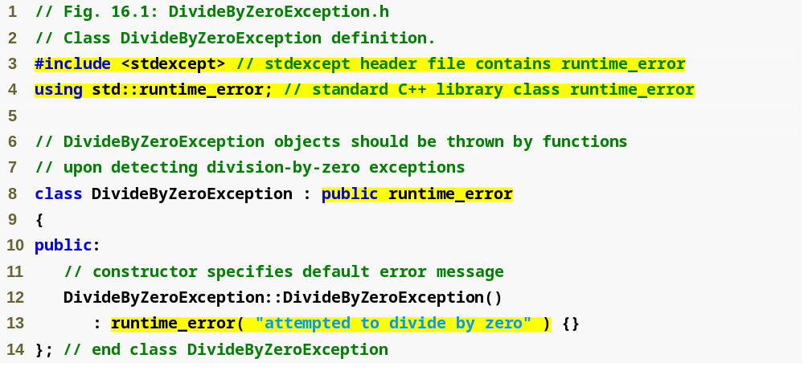
Outline
DivideBy
ZeroException.h
(1 of 1)

Slide 24
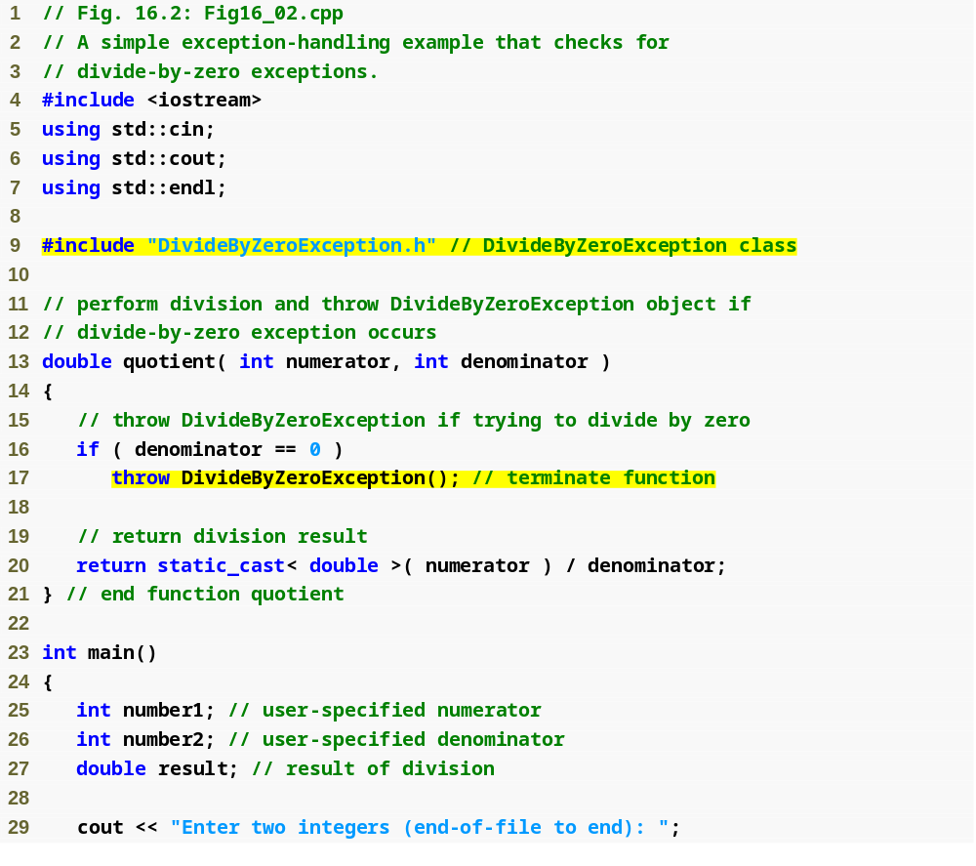
Outline
Fig16_02.cpp
(1 of 3)

Slide 25
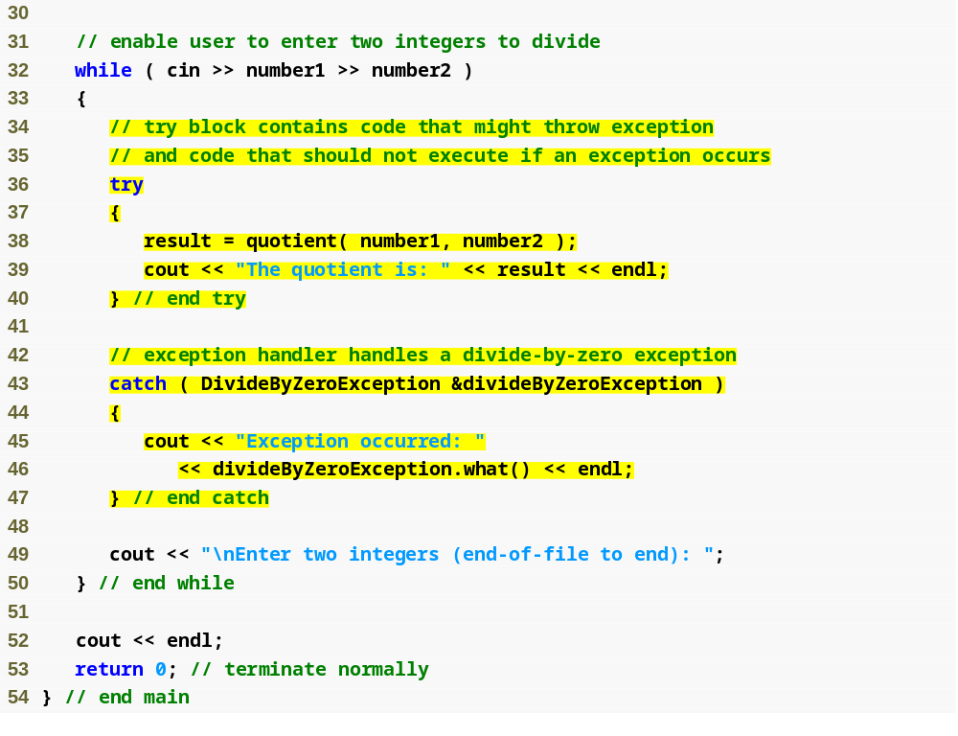
Outline
Fig16_02.cpp
(2 of 3)

Slide 26
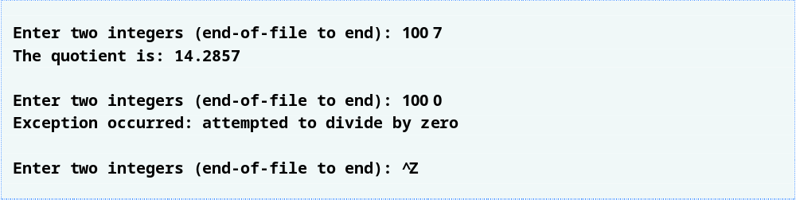
Outline
Fig16_02.cpp
(3 of 3)

Slide 27
Common Programming Error 16.5
Use caution when throwing the result of a conditional expression (?:), because promotion rules could cause the value to be of a type different from the one expected. For example, when throwing an int or a double from the same conditional expression, the conditional expression converts the int to a double. However, the catch handler always catches the result as a double, rather than catching the result as a double when a double is thrown, and catching the result as an int when an int is thrown.

Slide 28
Performance Tip 16.2
Catching an exception object by reference eliminates the overhead of copying the object that represents the thrown exception.

Slide 29
Good Programming Practice 16.1
Associating each type of runtime error with an appropriately named exception object improves program clarity.

Slide 30
16.4 When to Use Exception Handling
When to use exception handling
  To process synchronous errors
    Occur when a statement executes
  Not to process asynchronous errors
    Occur in parallel with, and independent of, program execution
  To process problems arising in predefined software elements
    Such as predefined functions and classes
    Error handling can be performed by the program code to be customized based on the application’s needs

Slide 31
Software Engineering Observation 16.3
Incorporate your exception-handling strategy into your system from the design process’s inception. Including effective exception handling after a system has been implemented can be difficult.

Slide 32
Software Engineering Observation 16.4
Exception handling provides a single, uniform technique for processing problems. This helps programmers working on large projects understand each other’s error-processing code.

Slide 33
Software Engineering Observation 16.5
Avoid using exception handling as an alternate form of flow of control. These “additional” exceptions can “get in the way” of genuine error-type exceptions.

Slide 34
Software Engineering Observation 16.6
Exception handling simplifies combining software components and enables them to work together effectively by enabling predefined components to communicate problems to application-specific components, which can then process the problems in an application-specific manner.

Slide 35
Performance Tip 16.3
When no exceptions occur, exception-handling code incurs little or no performance penalties. Thus, programs that implement exception handling operate more efficiently than do programs that intermix error-handling code with program logic.

Slide 36
Software Engineering Observation 16.7
Functions with common error conditions should return 0 or NULL (or other appropriate values) rather than throw exceptions. A program calling such a function can check the return value to determine success or failure of the function call.

Slide 37
16.5 Rethrowing an Exception
Rethrowing an exception
  Empty throw; statement
  Use when a catch handler cannot or can only partially process an exception
  Next enclosing try block attempts to match the exception with one of its catch handlers

Slide 38
Common Programming Error 16.6
Executing an empty throw statement that is situated outside a catch handler causes a call to function terminate, which abandons exception processing and terminates the program immediately.

Slide 39
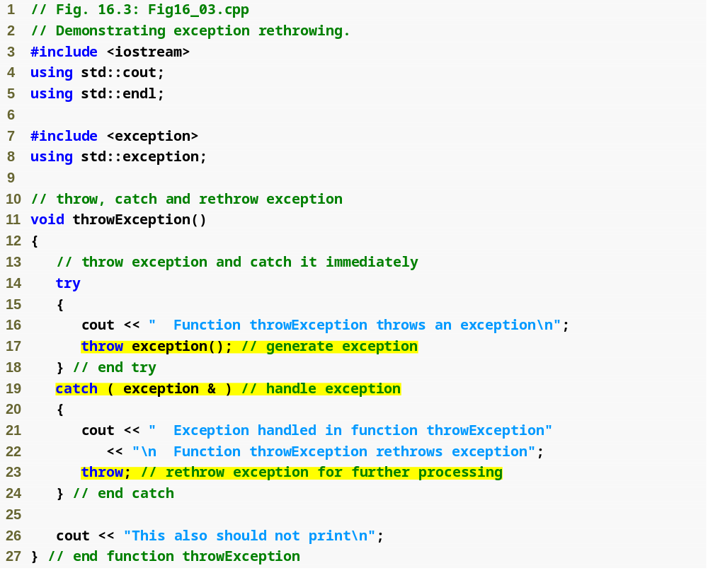
Outline
Fig16_03.cpp
(1 of 2)
Rethrow the exception

Slide 40
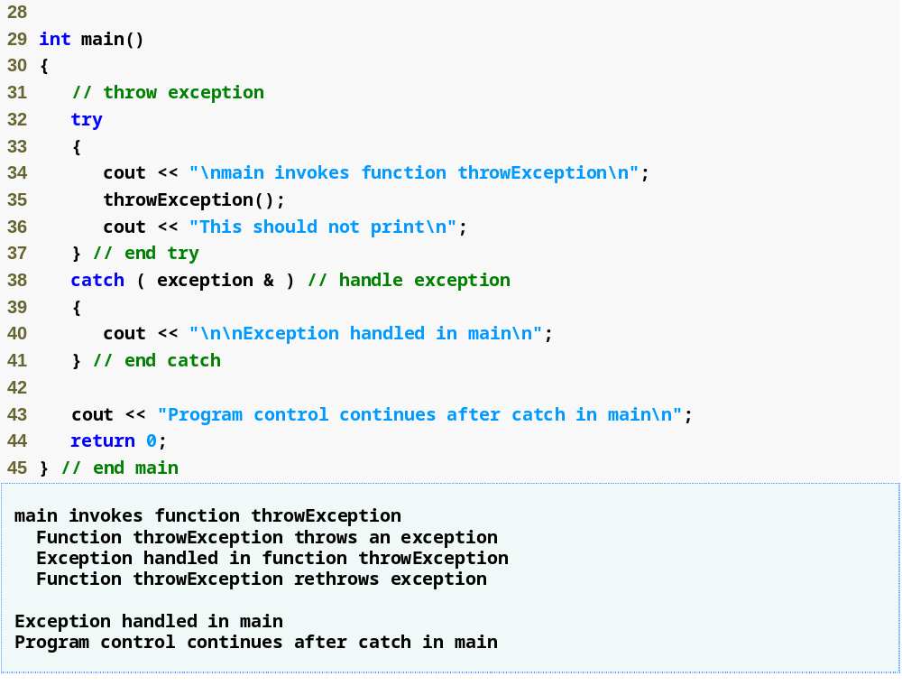
Outline
Fig16_03.cpp
(2 of 2)
Catch rethrown exception

Slide 41
16.6 Exception Specifications
Exception specifications (a.k.a. throw lists)
  Keyword throw
  Comma-separated list of exception classes in parentheses
  Example
    int someFunction( double value )
    throw ( ExceptionA, ExceptionB,
    ExceptionC )
    {
    …
    }
      Indicates someFunction can throw exceptions of types ExceptionA, ExceptionB and ExceptionC

Slide 42
16.6 Exception Specifications (Cont.)
Exception specifications (Cont.)
  A function can throw only exceptions of types in its specification or types derived from those types
    If a function throws a non-specification exception, function unexpected is called
      This normally terminates the program
  No exception specification indicates the function can throw any exception
  An empty exception specification, throw(), indicates the function can not throw any exceptions

Slide 43
Common Programming Error 16.7
Throwing an exception that has not been declared in a function’s exception specification causes a call to function unexpected.

Slide 44
Error-Prevention Tip 16.3
The compiler will not generate a compilation error if a function contains a throw expression for an exception not listed in the function’s exception specification. An error occurs only when that function attempts to throw that exception at execution time. To avoid surprises at execution time, carefully check your code to ensure that functions do not throw exceptions not listed in their exception specifications.

Slide 45
16.7 Processing Unexpected Exceptions
Function unexpected
  Called when a function throws an exception not in its exception specification
  Calls the function registered with function set_unexpected
  Function terminate is called by default
Function set_unexpected of <exception>
  Takes as argument a pointer to a function with no arguments and a void return type
  Returns a pointer to the last function called by unexpected
    Returns 0 the first time

Slide 46
16.7 Processing Unexpected Exceptions (Cont.)
Function terminate
  Called when
    No matching catch is found for a thrown exception
    A destructor attempts to throw an exception during stack unwinding
    Attempting to rethrow an exception when no exception is being handled
    Calling function unexpected before registering a function with function set_unexpected
  Calls the function registered with function set_terminate
  Function abort is called by default

Slide 47
16.8 Stack Unwinding
Stack unwinding
  Occurs when a thrown exception is not caught in a particular scope
  Unwinding a function terminates that function
    All local variables of the function are destroyed
    Control returns to the statement that invoked the function
  Attempts are made to catch the exception in outer try…catch blocks
  If the exception is never caught, function terminate is called

Slide 48
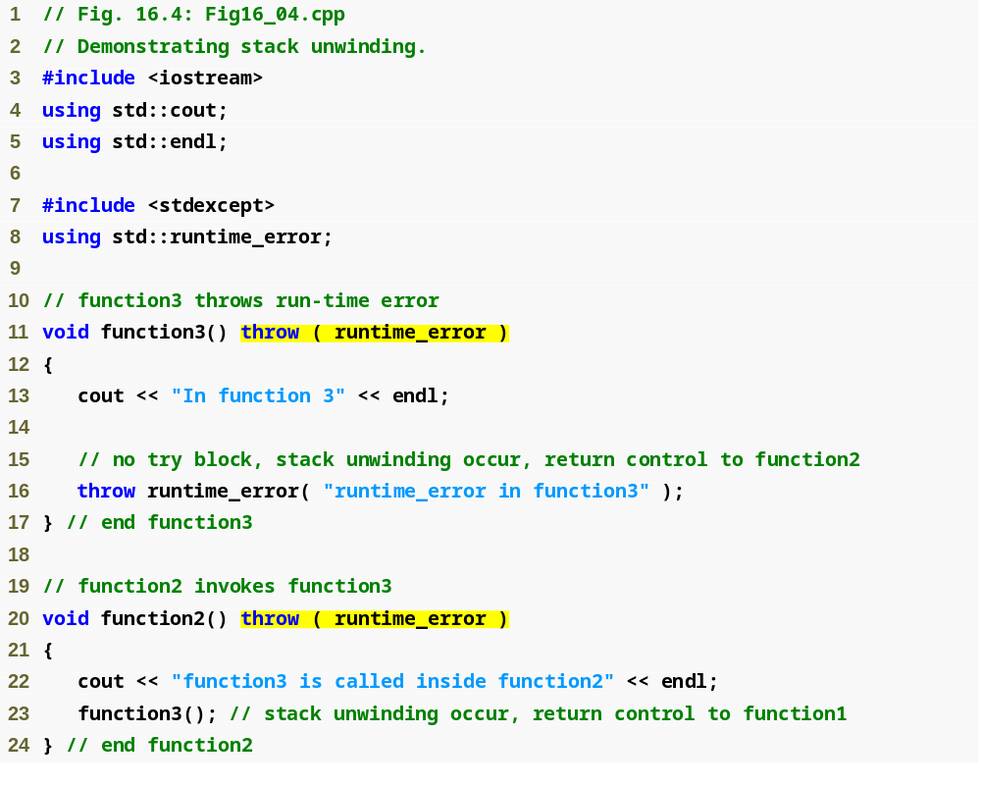
Outline
Fig16_04.cpp
(1 of 3)

Slide 49
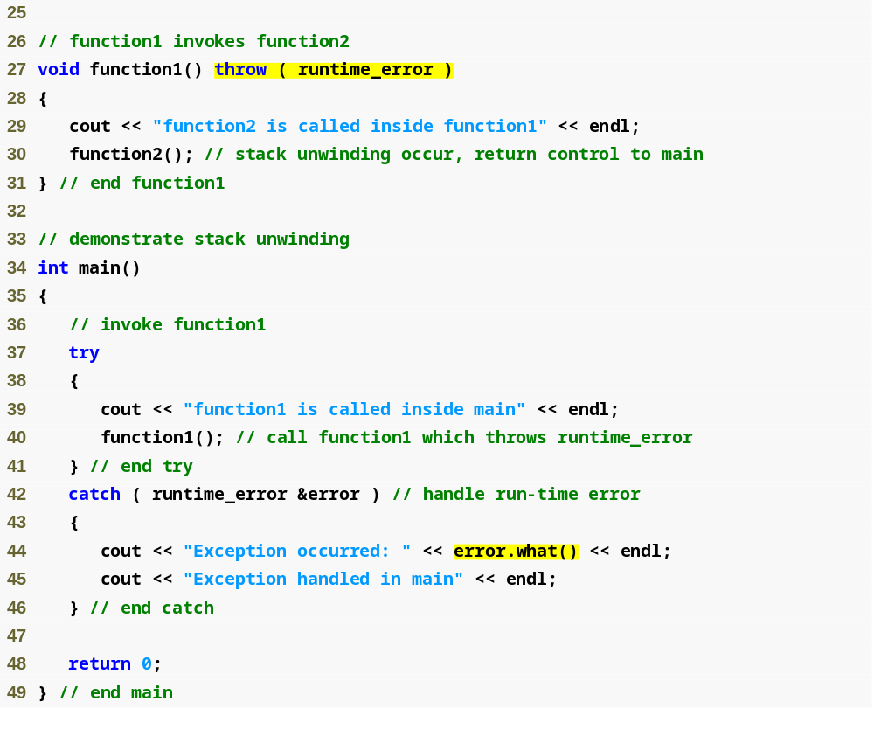
Outline
Fig16_04.cpp
(2 of 3)

Slide 50
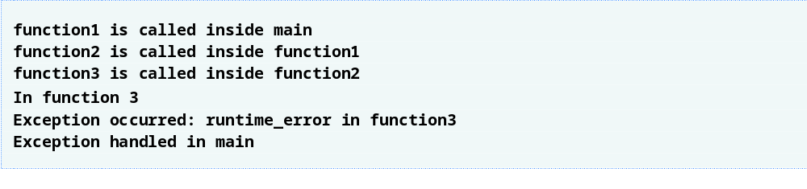
Outline
Fig16_04.cpp
(3 of 3)

Slide 51
16.9 Constructors, Destructors and Exception Handling
Exceptions and constructors
  Exceptions enable constructors, which cannot return values, to report errors to the program
  Exceptions thrown by constructors cause any already-constructed component objects to call their destructors
    Only those objects that have already been constructed will be destructed
Exceptions and destructors
  Destructors are called for all automatic objects in the terminated try block when an exception is thrown
    Acquired resources can be placed in local objects to automatically release the resources when an exception occurs
  If a destructor invoked by stack unwinding throws an exception, function terminate is called

Slide 52
Error-Prevention Tip 16.4
When an exception is thrown from the constructor for an object that is created in a new expression, the dynamically allocated memory for that object is released.

Slide 53
16.10 Exceptions and Inheritance
Inheritance with exception classes
  New exception classes can be defined to inherit from existing exception classes
  A catch handler for a particular exception class can also catch exceptions of classes derived from that class

Slide 54
Error-Prevention Tip 16.5
Using inheritance with exceptions enables an exception handler to catch related errors with concise notation. One approach is to catch each type of pointer or reference to a derived-class exception object individually, but a more concise approach is to catch pointers or references to base-class exception objects instead. Also, catching pointers or references to derived-class exception objects individually is error prone, especially if the programmer forgets to test explicitly for one or more of the derived-class pointer or reference types.

Slide 55
16.11 Processing new Failures
new failures
  Some compilers throw a bad_alloc exception
    Compliant to the C++ standard specification
  Some compilers return 0
    C++ standard-compliant compilers also have a version of new that returns 0
      Use expression new( nothrow ), where nothrow is of type nothrow_t
  Some compilers throw bad_alloc if <new> is included

Slide 56
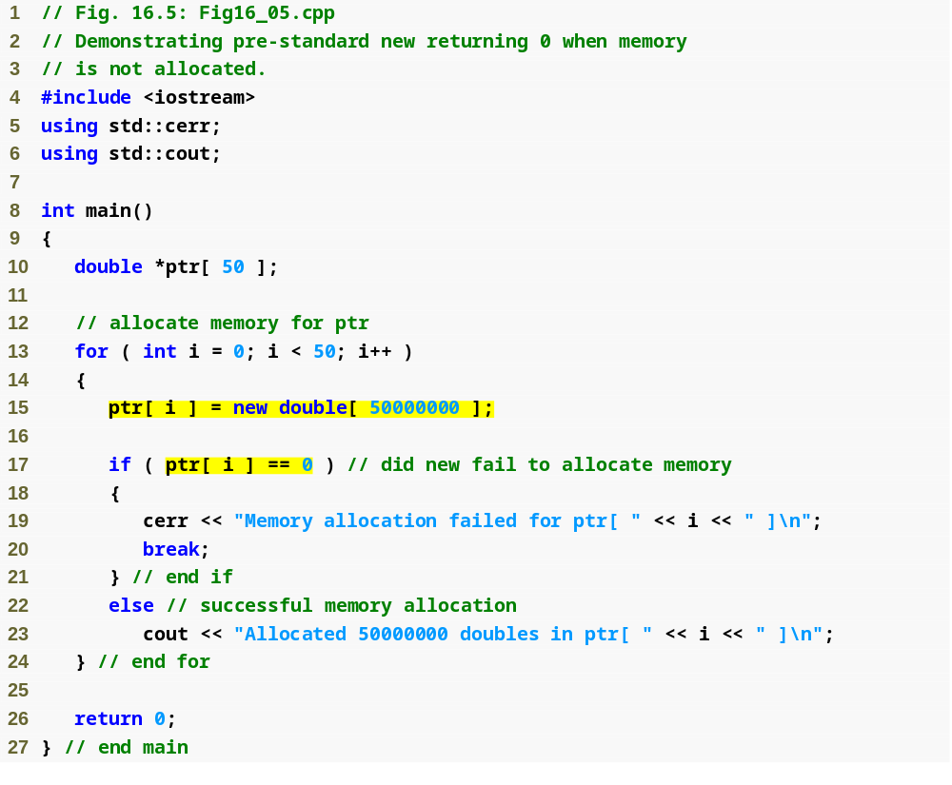
Outline
Fig16_05.cpp
(1 of 2)
Allocate 50000000 double values
new will have returned 0 if the memory allocation operation failed

Slide 57

Outline
Fig16_03.cpp
(2 of 2)

Slide 58
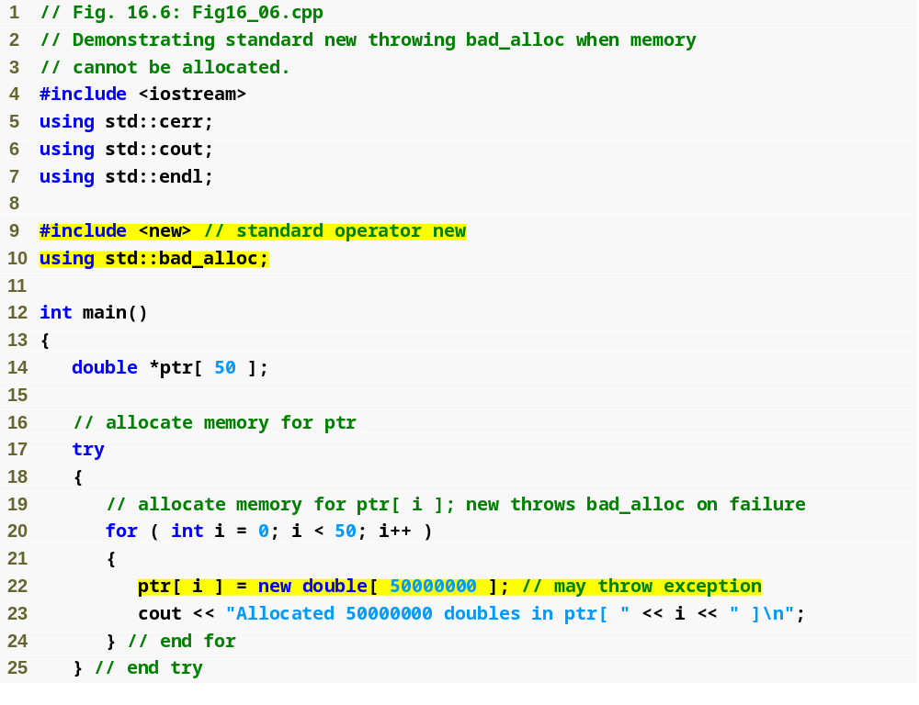
Outline
Fig16_06.cpp
(1 of 2)
Allocate 50000000 double values

Slide 59
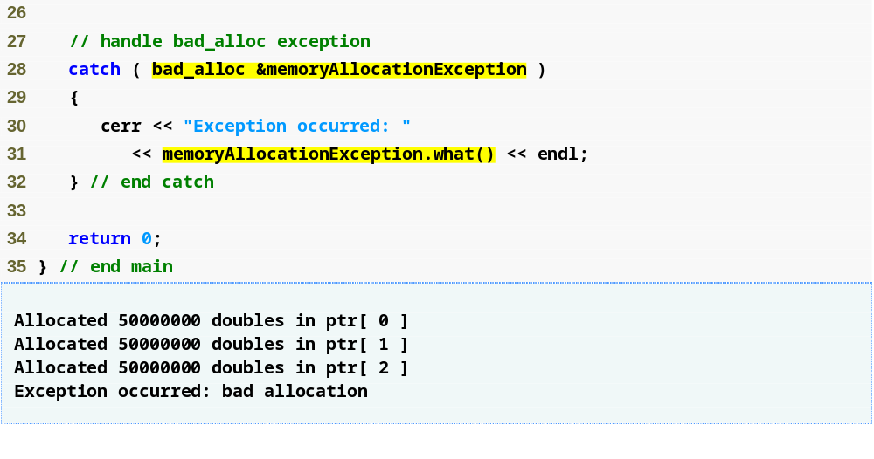
Outline
new throws a bad_alloc exception if the memory allocation operation failed
Fig16_06.cpp
(2 of 2)

Slide 60
Software Engineering Observation 16.8
To make programs more robust, use the version of new that throws bad_alloc exceptions on failure.

Slide 61
16.11 Processing new Failures (Cont.)
new failures (Cont.)
  Function set_new_handler
    Registers a function to handle new failures
      The registered function is called by new when a memory allocation operation fails
    Takes as argument a pointer to a function that takes no arguments and returns void
    C++ standard specifies that the new-handler function should:
      Make more memory available and let new try again,
      Throw a bad_alloc exception or
      Call function abort or exit to terminate the program

Slide 62
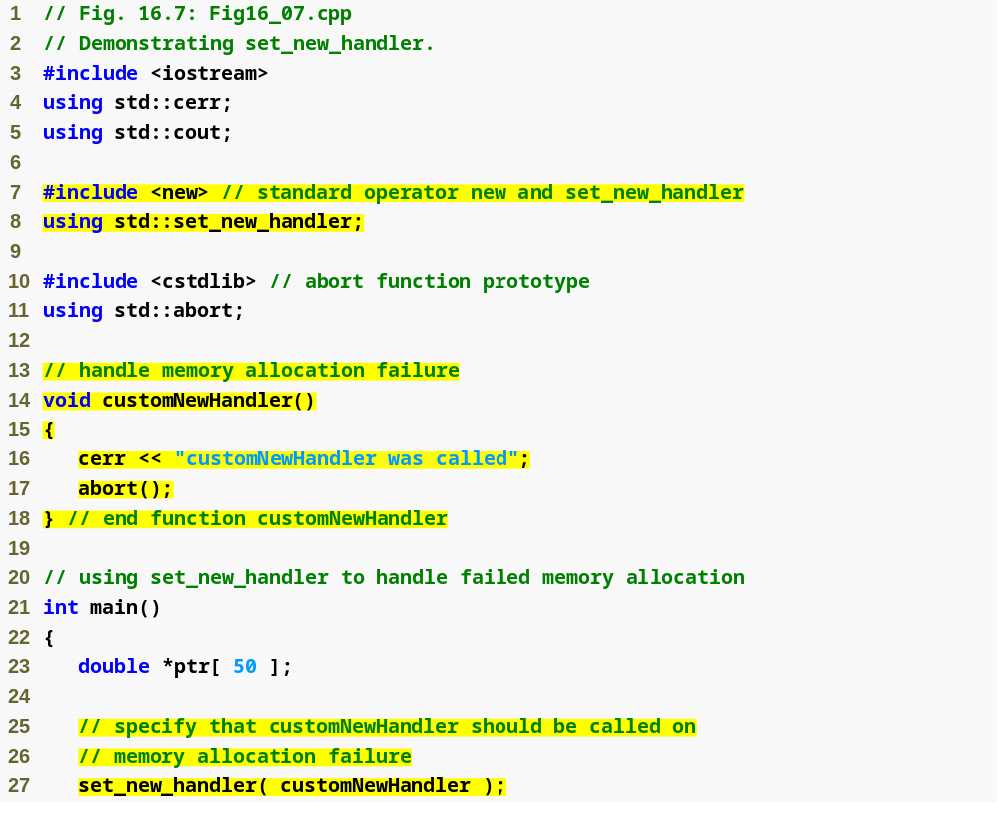
Outline
Fig16_07.cpp
(1 of 2)
Create a user-defined new-handler function customNewHandler
Register customNewHandler with set_new_handler

Slide 63
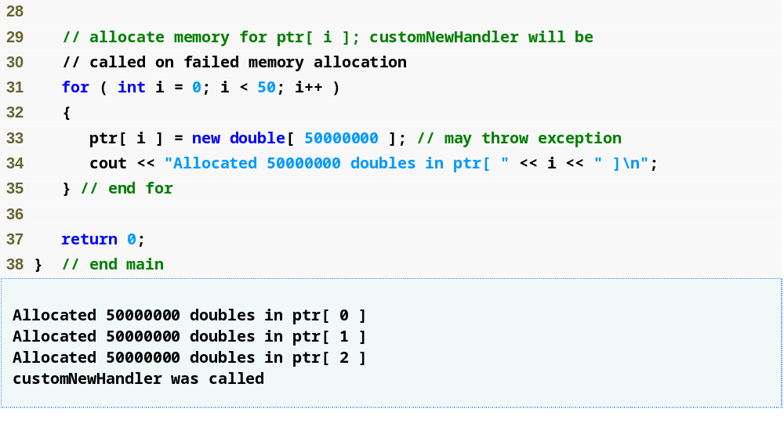
Outline
Allocate 50000000 double values
Fig16_07.cpp
(2 of 2)

Slide 64
16.12 Class auto_ptr and Dynamic Memory Allocation
Class template auto_ptr
  Defined in header file <memory>
  Maintains a pointer to dynamically allocated memory
    Its destructor performs delete on the pointer data member
      Prevents memory leaks by deleting the dynamically allocated memory even if an exception occurs
    Provides overloaded operators * and -> just like a regular pointer variable
    Can pass ownership of the memory via the overloaded assignment operator or the copy constructor
      The last auto_ptr object maintaining the pointer will delete the memory

Slide 65
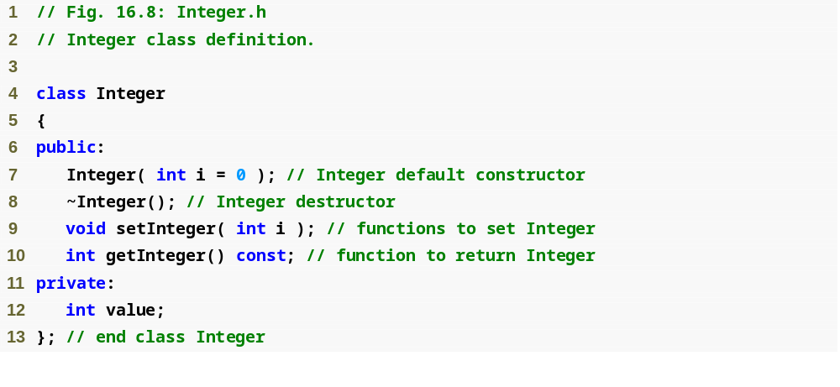
Outline
Integer.h
(1 of 1)

Slide 66
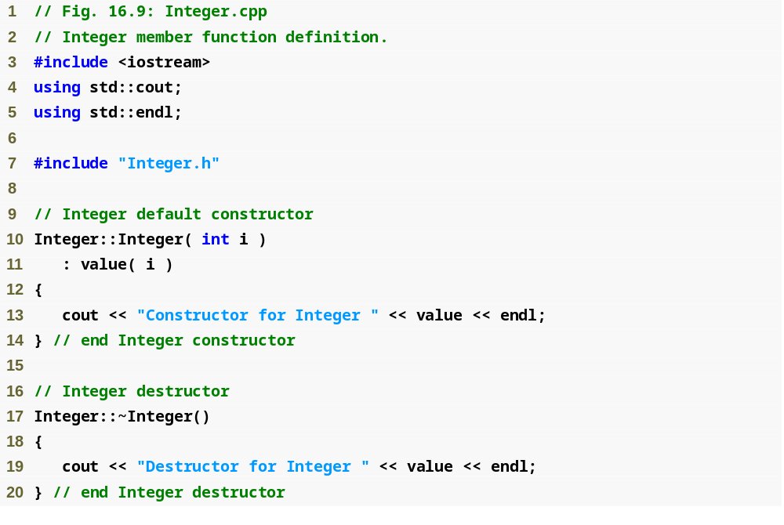
Outline
Integer.cpp
(1 of 2)

Slide 67
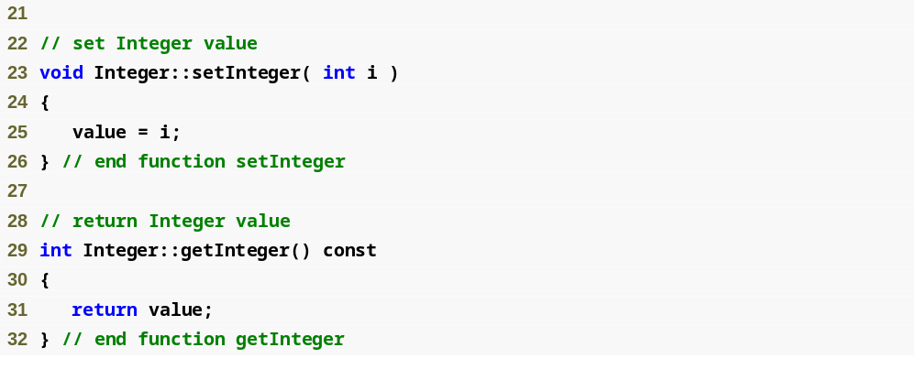
Outline
Integer.cpp
(2 of 2)

Slide 68
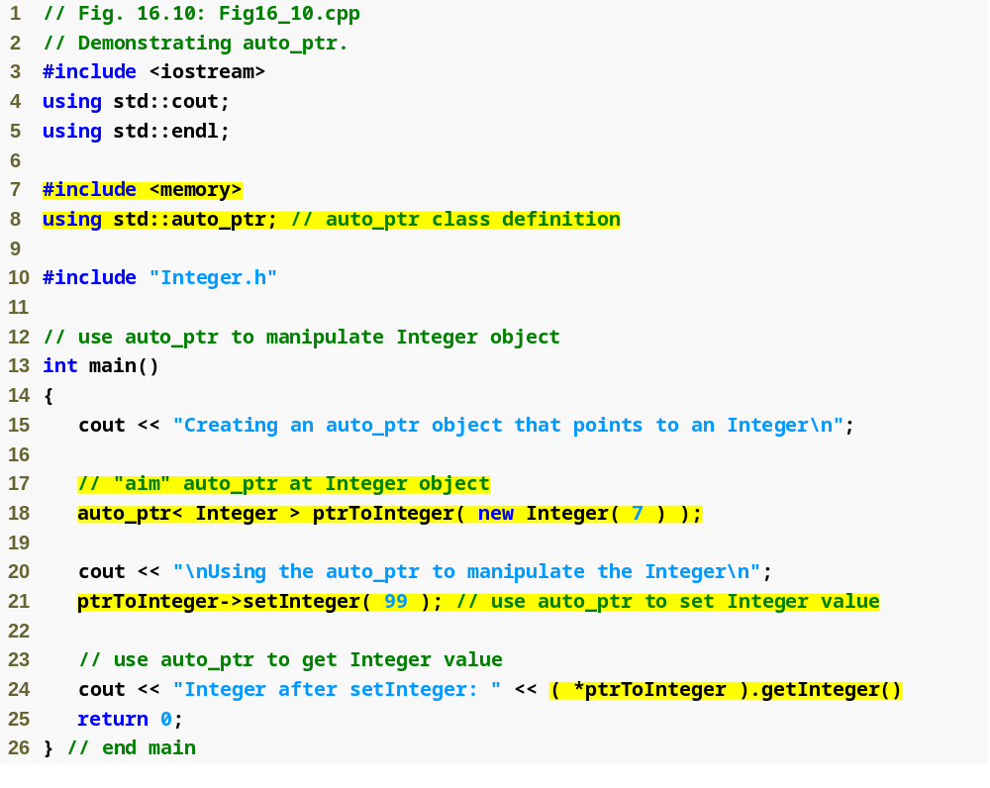
Outline
Fig16_10.cpp
(1 of 2)
Create an auto_ptr to point to a dynamically allocated Integer object
Manipulate the auto_ptr as if it were a pointer to an Integer
The dynamically allocated memory is automatically deleted by the auto_ptr when it goes out of scope

Slide 69
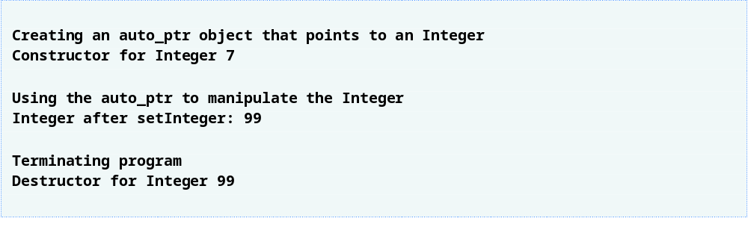
Outline
Fig16_10.cpp
(2 of 2)

Slide 70
16.13 Standard Library Exception Hierarchy
Exception hierarchy classes
  Base-class exception
    Contains virtual function what for storing error messages
    Exception classes derived from exception
      bad_alloc – thrown by new
      bad_cast – thrown by dynamic_cast
      bad_typeid – thrown by typeid
      bad_exception – thrown by unexpected
        Instead of terminating the program or calling the function specified by set_unexpected
        Used only if bad_exception is in the function’s throw list

Slide 71
Common Programming Error 16.8
Placing a catch handler that catches a base-class object before a catch that catches an object of a class derived from that base class is a logic error. The base-class catch catches all objects of classes derived from that base class, so the derived-class catch will never execute.

Slide 72
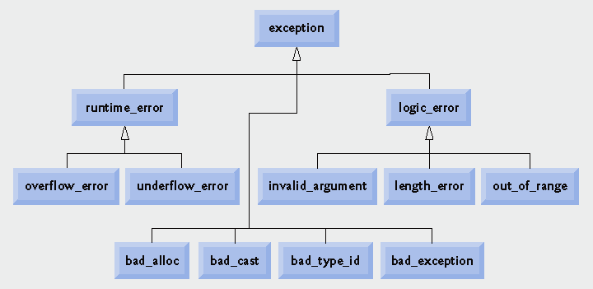
Fig. 16.11 | Standard Library exception classes.

Slide 73
16.13 Standard Library Exception Hierarchy (Cont.)
Exception hierarchy classes (Cont.)
  Class logic_error, derived from exception
    Indicates errors in program logic
    Exception classes derived from logic_error
      invalid_argument
        Indicates an invalid argument to a function
      length_error
        Indicates a length larger than the maximum size for some object was used
      out_of_range
        Indicates a value, such as an array subscript, exceeded its allowed range

Slide 74
16.13 Standard Library Exception Hierarchy (Cont.)
Exception hierarchy classes (Cont.)
  Class runtime_error, derived from exception
    Indicates execution-time errors
    Exception classes derived from runtime_error
      overflow_error
        Indicates an arithmetic overflow error – an arithmetic result is larger than the largest storable number
      underflow_error
        Indicates an arithmetic underflow error – an arithmetic result is smaller than the smallest storable number

Slide 75
Common Programming Error 16.9
Programmer-defined exception classes need not be derived from class exception. Thus, writing catch( exception anyException) is not guaranteed to catch all exceptions a program could encounter.

Slide 76
Error-Prevention Tip 16.6
To catch all exceptions potentially thrown in a try block, use catch(...). One weakness with catching exceptions in this way is that the type of the caught exception is unknown at compile time. Another weakness is that, without a named parameter, there is no way to refer to the exception object inside the exception handler.

Slide 77
Software Engineering Observation 16.10
The standard exception hierarchy is a good starting point for creating exceptions. Programmers can build programs that can throw standard exceptions, throw exceptions derived from the standard exceptions or throw their own exceptions not derived from the standard exceptions.

Slide 78
Software Engineering Observation 16.11
Use catch(...) to perform recovery that does not depend on the exception type (e.g., releasing common resources). The exception can be rethrown to alert more specific enclosing catch handlers.

Slide 79
16.14 Other Error-Handling Techniques
Other error-handling techniques
  Ignore the exception
    Devastating for commercial and mission-critical software
  Abort the program
    Prevents a program from giving users incorrect results
    Inappropriate for mission-critical applications
    Should release acquired resources before aborting
  Set error indicators
  Issue an error message and pass an appropriate error code through exit to the program’s environment

Slide 80
Common Programming Error 16.10
Aborting a program component due to an uncaught exception could leave a resource—such as a file stream or an I/O device—in a state in which other programs are unable to acquire the resource. This is known as a “resource leak.”

Slide 81
16.14 Other Error-Handling Techniques (Cont.)
Other error-handling techniques (Cont.)
  Use functions setjump and longjump
    Defined in library <csetjmp>
    Used to jump immediately from a deeply nested function call to an error handler
      Unwind the stack without calling destructors for automatic objects
  Use a dedicated error-handling capability
    Such as a new_handler function registered with set_new_handler for operator new

